Slide 1
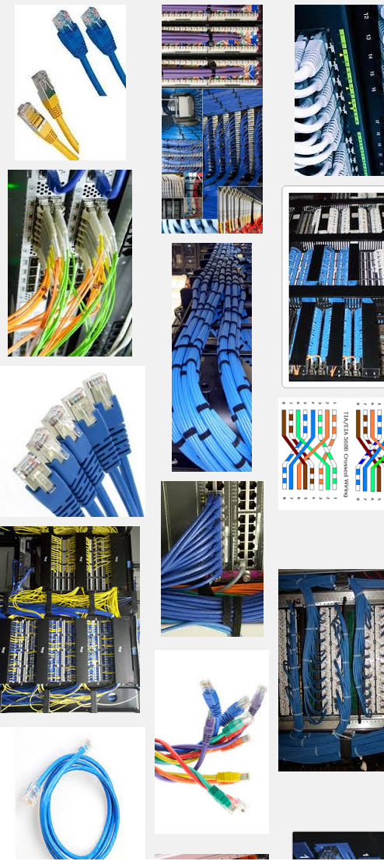
Network Cabling
Making connections with Cat6

Slide 2
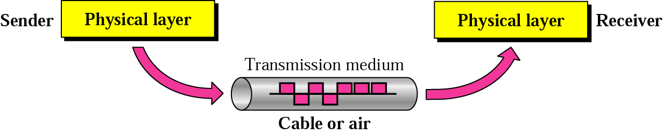
Data Transmission
Physical Media
Notes:
‹#›

Slide 3
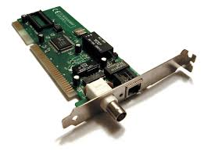
Network interface cards (NIC)
Physical Media
The NIC provides the physical connection between the network and the computer workstation.
The NIC contains the electronic circuitry required to communicate using a wired connection (e.g., Ethernet) or a wireless connection (e.g., WiFi).
Also known as network interface controller, network adapter, or Local Area Network (LAN) adapter.
Notes:
‹#›

Slide 4
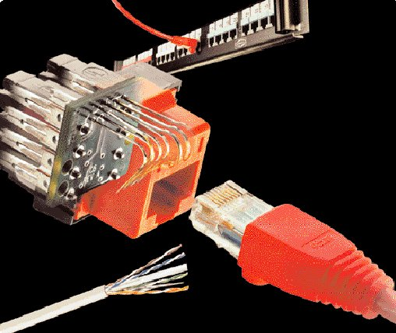
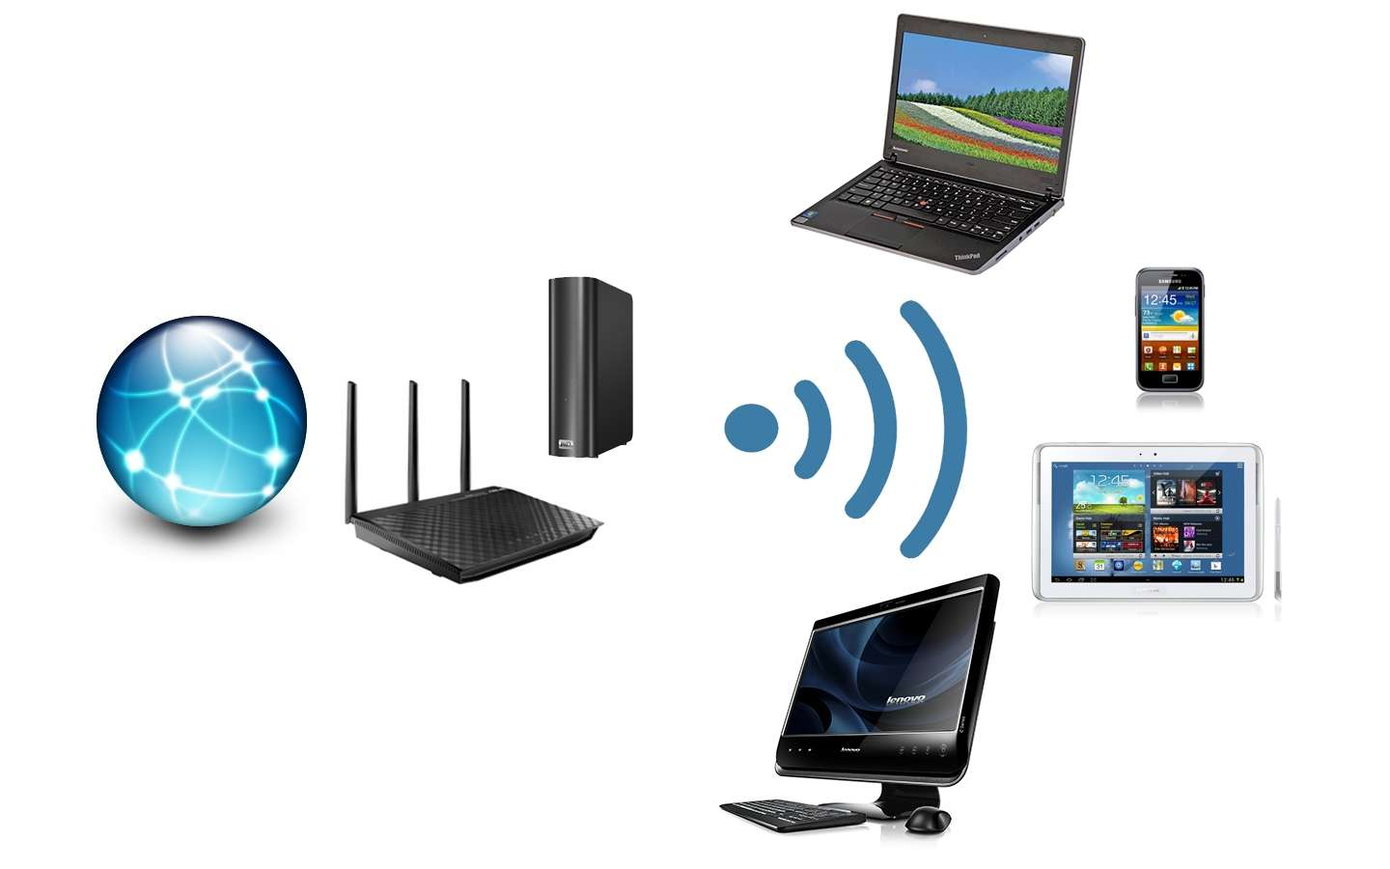
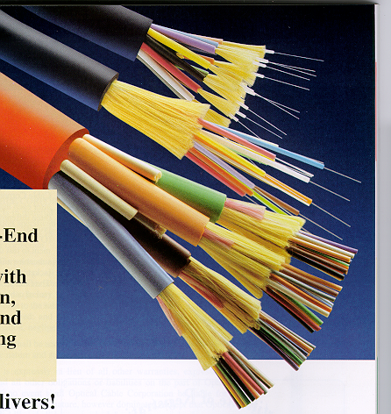
Transmission MEDIA
Physical Media
Notes:
‹#›

Slide 5
Media
Physical Media
Copper
Coaxial Cable - Thick or Thin
Unshielded Twisted Pair - CAT 3,4,5,5e&6
Optical Fiber
Multimode – multiple rays
Singlemode – a single ray
Wireless
Short Range
Medium Range (Line of Sight)
Satellite
Notes:
‹#›

Slide 6
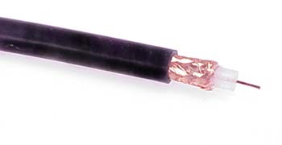
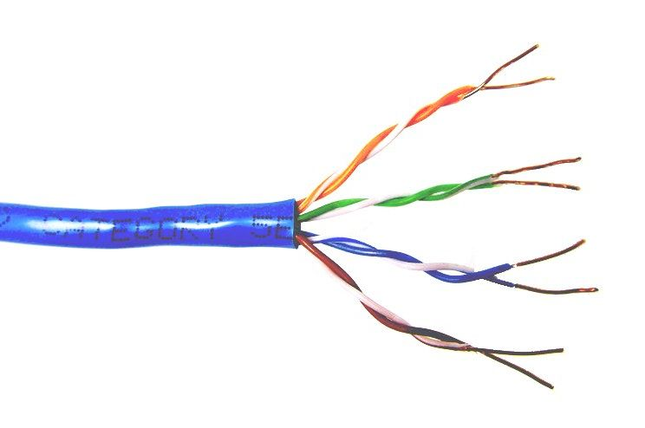
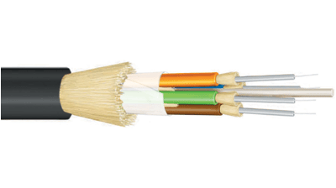
Common types of cable used in Wired Medium
Coaxial cable
Unshielded twisted pair
Fiber optic

Slide 7
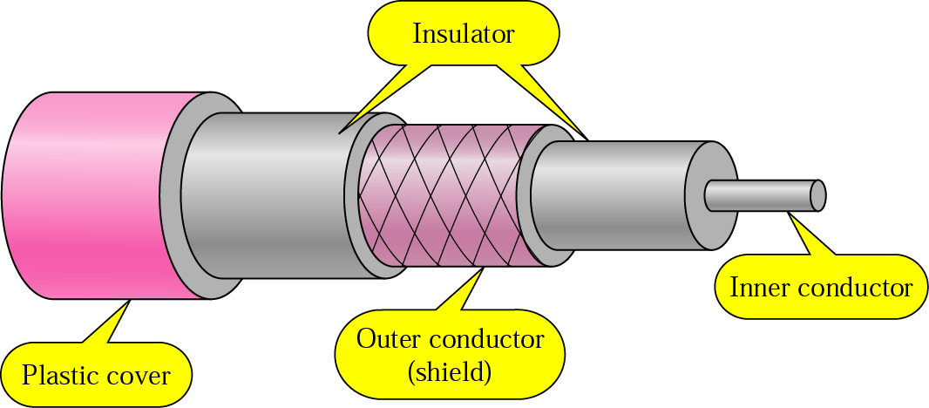
Copper Media: Coaxial Cable
Physical Media
Coaxial cable is a copper-cored cable surrounded by heavy shielding and is used to connect computers in a network.
Outer conductor shields the inner conductor from picking up a stray signal from the air.
High bandwidth but a lossy channel.
Repeater is used to regenerate the weakened signals.
Category | Impedance | Use
RG-59 | 75 Ω | Cable TV
RG-58 | 50 Ω | Thin Ethernet
RG-11 | 50 Ω | Thick Ethernet
Notes:
‹#›

Slide 8
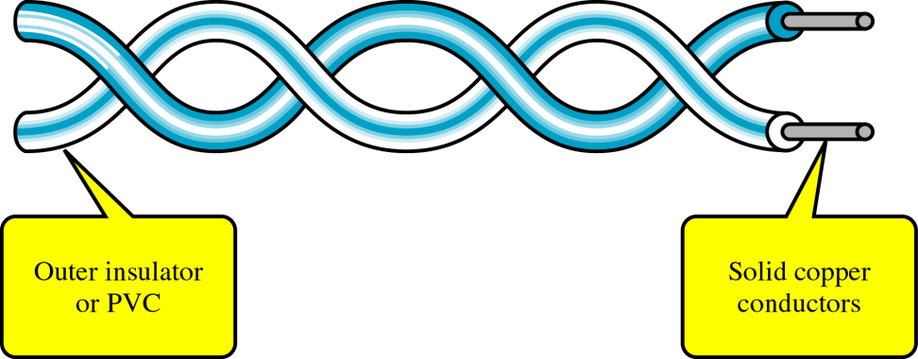
Copper Media: Twisted Pair
Physical Media
Twisted-pair is a type of cabling that is used for telephone communications and most modern Ethernet networks.
A pair of wires forms a circuit that can transmit data. The pairs are twisted to provide protection against crosstalk, the noise generated by adjacent pairs.
There are two basic types, shielded twisted-pair (STP) and unshielded twisted-pair (UTP).
Notes:
‹#›

Slide 9
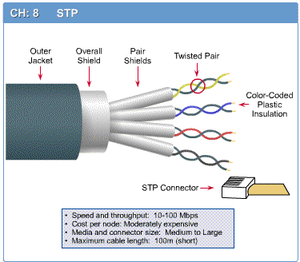
Shielded Twisted Pair (STP)
Physical Media
Also known as shielded twisted pair (STP) cable.
It features individual wire pairs wrapped in foil.
These pairs are wrapped one more time to provide double protection.
The shielding helps prevent electromagnetic interference (EMI) and other technical issues that may compromise signals’ integrity.
Notes:
‹#›

Slide 10
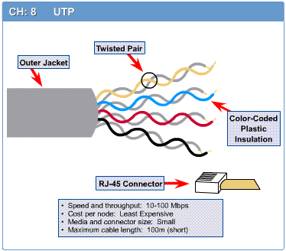
Unshielded Twisted Pair (UTP)
Physical Media
UTP cable is a 100-ohm copper cable.
Consists of 2 to 1800 unshielded twisted pairs surrounded by an outer jacket.
They have no metallic shield.
This makes the cable small in diameter but unprotected against electromagnetic interference (EMI).
Notes:
‹#›

Slide 11
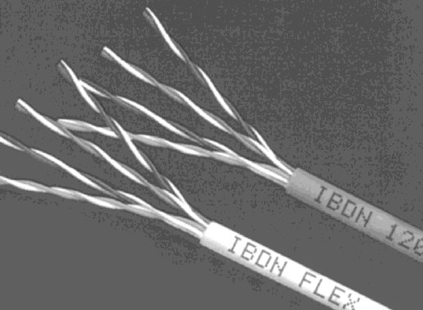
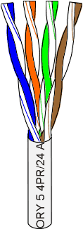
Unshielded Twisted Pair (UTP)
Physical Media
Consists of 4 pairs (8 wires) of insulated copper wires typically about 1 mm thick.
The wires are twisted together in a helical form.
Twisting reduces the interference between pairs of wires.
High bandwidth and High attenuation channel.
Flexible and cheap cable.
Category rating based on the number of twists per inch and the material used.
CAT 3, CAT 4, CAT 5, Enhanced CAT 5, and now CAT 6.
Notes:
‹#›

Slide 12
Categories of UTP
Physical Media
UTP comes in several categories that are based on the number of twists in the wires, the diameter of the wires, and the material used in the wires.
Category 3 is the wiring used primarily for telephone connections.
Category 5e and Category 6 are currently the most common Ethernet cables used.
Notes:
‹#›

Slide 14
Categories of UTP: CAT 3
Physical Media
Bandwidth 16 Mhz
Contains 4 pairs of wires and can carry up to 10Mbps
Used in voice applications and 10baseT (10Mbps) Ethernet
Notes:
‹#›

Slide 15
Categories of UTP: CAT 4
Physical Media
20 MHz Bandwidth
contains 4 pairs of wires and can carry up to 16Mbps
Used in 10baseT (10Mbps) Ethernet
Notes:
‹#›

Slide 16
Categories of UTP: CAT 5
Physical Media
100 MHz Bandwidth
Contains 4 pairs of wires and can carry up to 100Mbps
Used in 10BaseT (10 Mbps) Ethernet & Fast Ethernet (100 Mbps)
Notes:
‹#›

Slide 17
Categories of UTP: CAT 5e
Physical Media
150 MHz Bandwidth
a higher grade of CAT5 that contains high-quality copper
Used in Fast Ethernet (100 Mbps), Gigabit Ethernet (1000 Mbps)
Notes:
‹#›

Slide 18
Categories of UTP: CAT 6
Physical Media
250 MHz Bandwidth
a twisted pair cable that contains 4 wire pairs each wrapped in foil insulation
Transmits high-speed data
Used in Gigabit Ethernet (1000 Mbps) & 10 Gig Ethernet (10000 Mbps)
Notes:
‹#›

Slide 19
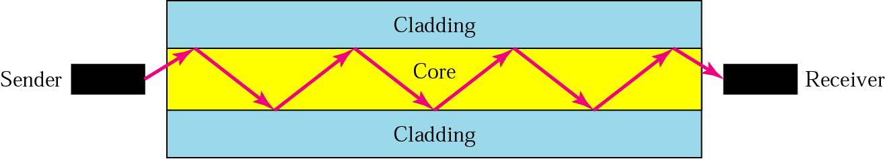
Fiber Media
Physical Media
Optical fibers use light to send information through the optical medium.
It uses the principle of total internal reflection.
Modulated light transmissions are used to transmit the signal.
Notes:
‹#›

Slide 20
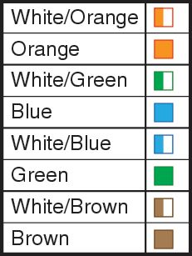
Cabling Standards
Physical Media
Cabling is an integral part of building any network.
When installing cable, it is important to follow cabling standards, which have been developed to ensure data networks operate to agreed levels of performance.
Cabling standards are a set of specifications for the installation and testing of cables.
Notes:
‹#›

Slide 21
Twisted Pair Cables
Physical Media
Twisted pair cable is most commonly used in network installations.
The TIA/EIA organization defines two different patterns, or wiring schemes, called T568A and T568B.
Each wiring scheme defines the pinout, or order of wire connections, on the end of the cable.
The two schemes are similar except two of the four pairs are reversed in the termination order.
TIA (Telecommunications Industry Association)
EIA (Electronics Industries Alliance)
Notes:
‹#›

Slide 22
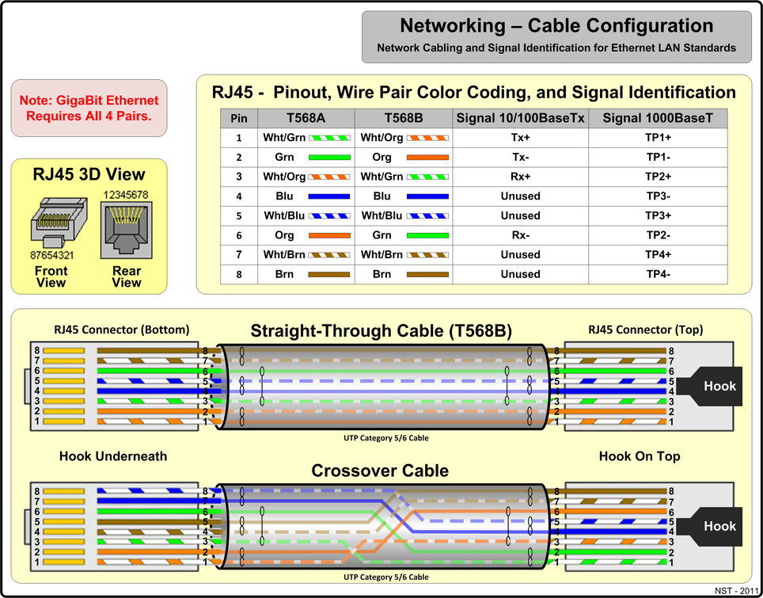
Twisted Pair Cables
Physical Media
Notes:
‹#›

Slide 23
What does +(plus) and -(minus) sign mean in cable pairs for RJ45
The positive and negative connectors in the cabling mentioned, form a balanced pair for signals. They typically carry identical signals of opposite polarity, i.e. a HIGH bit may be +5 Volts on the + conductor, and -5 Volts on the - conductor. The corresponding LOW bit would then be -5 Volts on the + conductor, and +5 Volts on the - conductor.
Having such signals of opposite polarity in a twisted pair of wires helps in reducing susceptibility to common-mode noise / EMI. Because the voltage difference between the two conductors for any valid bit is twice the actual signaling voltage, this has the effect of doubling the strength and hence the detection of the signal at the receiving end.
Specific to the cabling / protocol involved, various signaling schemes may be used for transmitting the actual bits down the line, from the simple Gray Code, to more complex non-return-to-zero (NRZ) or other coding.

Slide 24
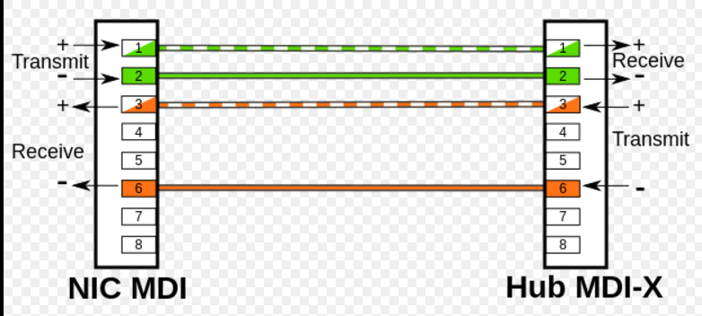

Slide 25
Twisted Pair Cables
Physical Media
On a network installation, one of the two wiring schemes (T568A or T568B) should be chosen and followed.
Notes:
‹#›

Slide 26
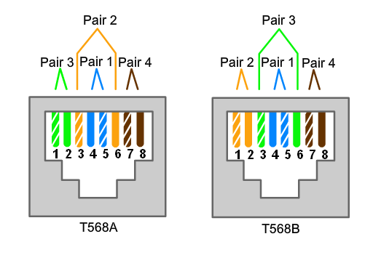
Twisted Pair Cables
‹#›

Slide 27
Twisted Pair Cables
Using the T568A and T568B wiring schemes, two types of cables can be created:
a straight-through cable
a crossover cable.
These two types of cable are found in data installations.
‹#›

Slide 28
Straight-through Cable
A Straight-through cable is the most common cable type.
It maps a wire to the same pins on both ends of the cable.
If T568A is on one end of the cable, T568A is also on the other.
If T568B is on one end of the cable, T568B is on the other.
This means that the order of connections (the pinout) for each color is the exact same on both ends.
‹#›

Slide 29
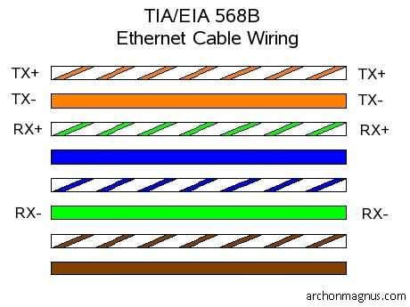
Straight-through Cable
‹#›

Slide 30
Crossover Cable
A crossover cable uses both wiring schemes.
T568A on one end of the cable and T568B on the other end of the same cable. This means that the order of connections on one end of the cable does not match the order of connections on the other.
The straight-through and crossover cables each have a specific use on the network. The type of cable needed to connect two devices depends on which wire pairs the devices use to transmit and receive data.
‹#›

Slide 31
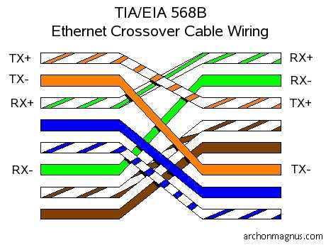
Crossover Cable
‹#›

Slide 32
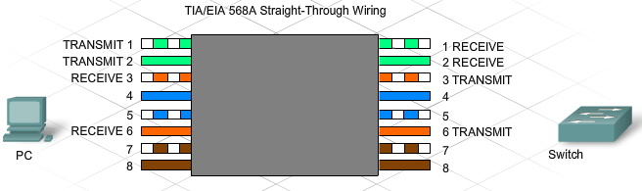
Working with Twisted-Pair Cabling
Specific pins on the connector are associated with a transmit function and a receive function. The transmit pin versus the receive pin is determined by the device being used.
‹#›

Slide 33
Unlike and Like Devices
Two devices directly connected and using different pins to transmit and receive are known as unlike devices. They require a straight-through cable to exchange data.
Devices that are directly connected and use the same pins to transmit and receive, are known as like devices. They require the use of a crossover cable to exchange data.
‹#›

Slide 34
Unlike and Like Devices
Examples of unlike devices that require a straight-through cable include:
Switch port to router port
Hub port to PC
‹#›

Slide 35
Unlike and Like Devices
If a PC is directly connected to another PC (like devices), pins 1 and 2 on both devices are transmit pins and pins 3 and 6 are receive pins.
A crossover cable would ensure that the green wire connected to pins 1 and 2 (transmit pins) on one PC connect to pins 3 and 6 (receive pins) on the other PC.
If a straight-through cable were used, the wire connected to pin 1, the transmit pin, on PC1 would be connected to pin 1, the transmit pin, on PC2. It is not possible to receive data on a transmit pin.
‹#›

Slide 36
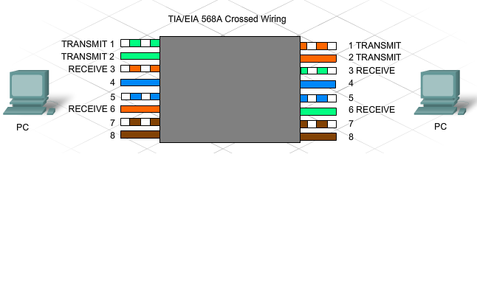
Unlike and Like Devices
‹#›

Slide 37
Unlike and Like Devices
Other examples of like devices that require a crossover cable include:
Switch port to switch port
Switch port to hub port
Hub port to hub port
Router port to router port
PC to PC
If the incorrect cable type is used, the connection between network devices will not function.
Some devices can automatically sense which pins are used for transmit and receive and will adjust their internal connections accordingly.
‹#›

Slide 38
Rollover Cable
Rollover cable (also known as Cisco console cable) is a type of null-modem cable that is most commonly used to connect a computer terminal to a router's console port.
Cisco routers and switches are normally configured over their console ports.
This cable is typically flat and the colour is also different to help distinguish it from other types of network cabling.
It gets the name rollover because the pinouts on one end are reversed from the other, as if the wire had been rolled over and you were viewing it from the other side.
‹#›

Slide 39
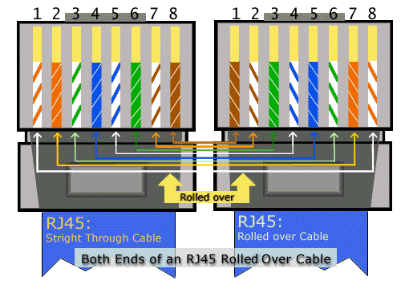
Rollover Cable
‹#›

Slide 40
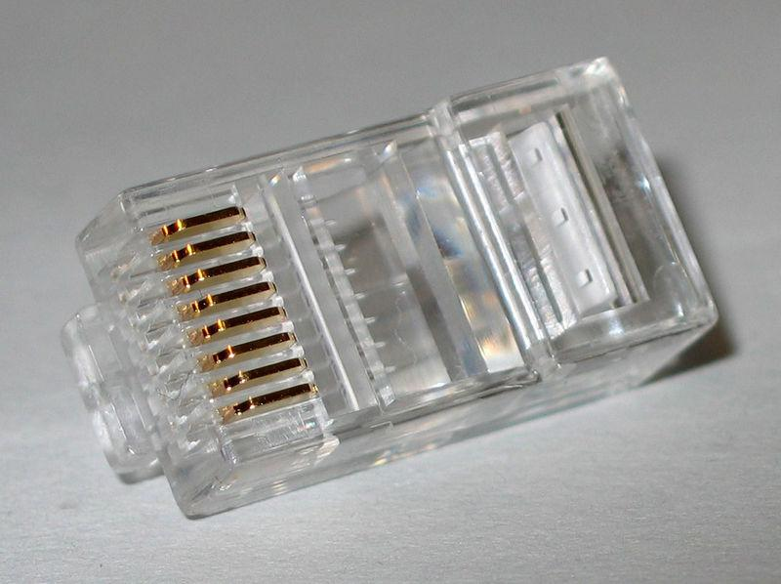
RJ45 connector

Slide 41

Making connections - Tools
Cat5e cable
RJ45 connectors
Cable stripper
Scissors
Crimping tool

Slide 42
Making connections - Steps
Strip cable end
Untwist wire ends
Arrange wires
Trim wires to size
Attach connector
Check
Crimp
Test

Slide 43
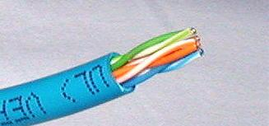
Step 1 – Strip cable end
Strip 1 – 1½” of insulating sheath
Avoid cutting into conductor insulation

Slide 44
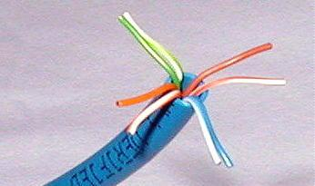
Step 2 – Untwist wire ends
Sort wires by insulation colors

Slide 45
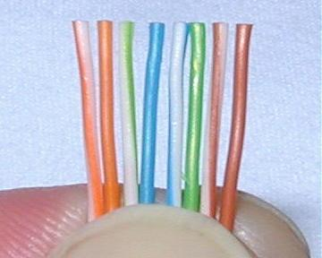
Step 3 – Arrange wires
TIA/EIA 568A: GW-G OW-Bl BlW-O BrW-Br
TIA/EIA 568B: OW-O GW-Bl BlW-G BrW-Br

Slide 46
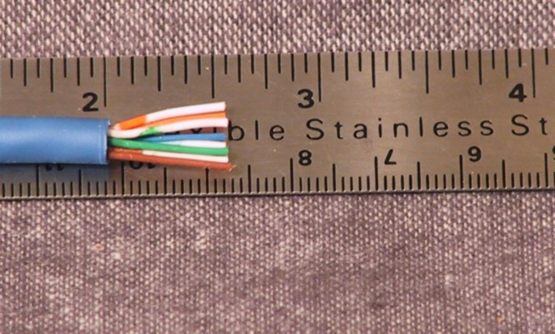
Step 4 – Trim wires to size
Trim all wires evenly
Leave about ½” of wires exposed

Slide 47
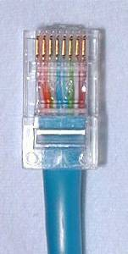
Step 5 – Attach connector
Maintain wire order, left-to-right, with RJ45 tab facing downward

Slide 48
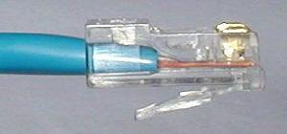
Step 6 - Check
Do all wires extend to end?
Is sheath well inside connector?

Slide 49
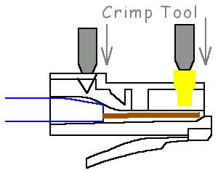
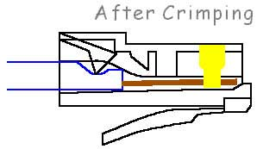
Step 7 - Crimp
Squeeze firmly to crimp connecter onto cable end (8P)

Slide 50
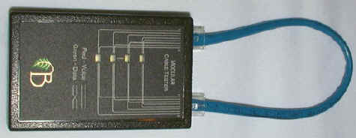
Step 8 – Test
Does the cable work?

Slide 51
Marks
10/10 = a successful cable that is prepped, crimped, and connects properly.
05/10 = a cable that does not work but is set-up reasonably well and has a detailed typed response as to possible solutions or reasons as to why the cable does not work.
0/10 = cable does not work and no explanation as to why.

Slide 52

LET’S GET STARTED!!

Slide 53
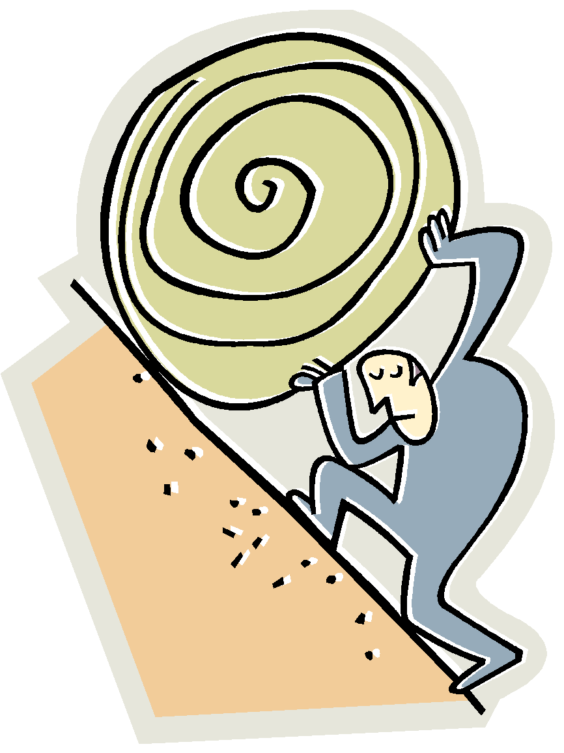
Let’s go to work!

